Slide 1


Amvion AI Consulting
Powered by observelite olgpt your custom built ai solution

Slide 2

OLGPT – Customized GenAI Solution
Customizable AI based platform, with plugins that integrate with business applications
Multi-Lingual AI Processing, Supports Indic Languages too
Multi-Industry use cases

Slide 3

Automation
Multi-Language Support
Integration With Existing Systems
Realtime Summarization with Analytics
Highly Secure & Compliant
Customizable & Scalable
Multi-Industry Use Cases
Interpret Images
OLGPT
OLGPT

Slide 4

Use Cases

Slide 5
Use Case – OL GPT
Challenges:
Too many data sources & formats
Correlation across takes too many Dev Sprints
Difficulty in extracting actionable insights
Current GenAI tools expect enterprise data to be exposed outside. Corporate network
As usage increases, the cost also increases
Health-Care
Manufacturing
Edu-Tech
Marketing
Human Resources
Insurance & Finance

Slide 6
Use Case – OL GPT
Solution By OLGPT:
Provides out of box plugins to integrate with existing enterprise tools / applications
Fully customizable GenAI platform that gives insights from Day “0”
Auto-Correlation with fine-tuning options available
Fully on-prem / private to enterprise deployment
Fixed platform cost
Health-Care
Manufacturing
Edu-Tech
Marketing
Human Resources
Insurance & Finance

Slide 7
Use Case – OL GPT
Benefits:
Out of Box solution minimizing deployment and customization time
Plug-in store helps in reducing integration time for 3rd Party tools / apps
Highly Secure, your data stays in-house, including AI driven insights
Pay as you go pricing options that are budget friendly.
Health-Care
Manufacturing
Edu-Tech
Marketing
Human Resources
Insurance & Finance

Slide 8
Industry
Applications
Customized AI for Every Sector

Slide 9
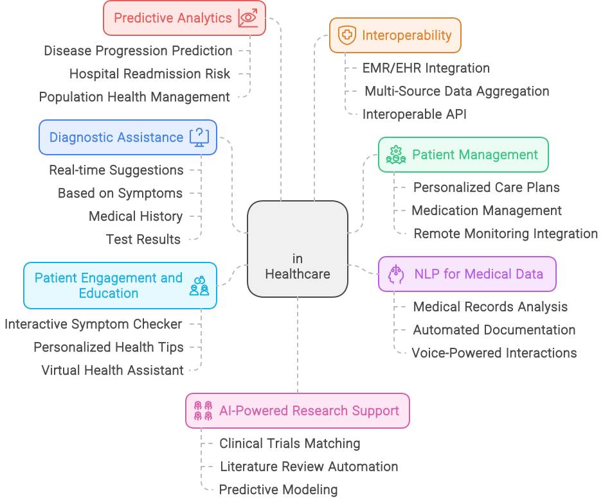
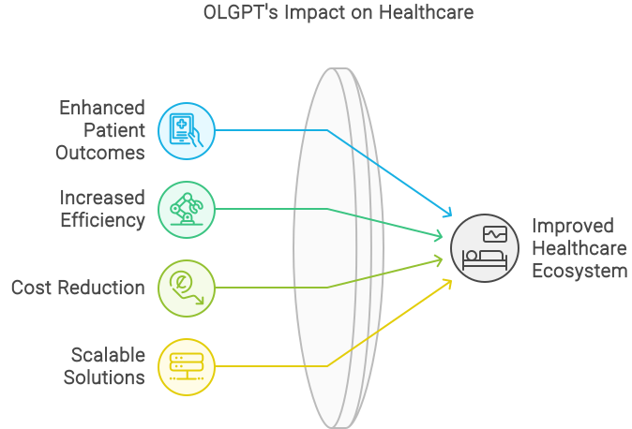

OLGPT in Healthcare
Our Success Story: A hospital increased patient flow by 30% with OLGPT chat support.
Notes:
Key features of OLGPT for healthcare:
Real-Time Diagnostic Assistance: OLGPT provides accurate, real-time diagnostic suggestions by analyzing patient symptoms, medical history, and test results.
Personalized Treatment Plans: It generates tailored, evidence-based treatment recommendations, including medication, therapy options, and follow-up care.
Comprehensive Patient Management: OLGPT creates individualized care plans for chronic disease management and integrates with wearable devices for real-time monitoring.
NLP-Driven Medical Data Analysis: The system uses natural language processing to extract and analyze data from unstructured medical records, automating documentation.
Predictive Analytics for Better Outcomes: OLGPT predicts disease progression and hospital readmission risks, enabling early interventions.
Seamless Integration and Compliance: It integrates with existing EMR/EHR systems, ensures HIPAA-compliant data privacy, and provides secure telemedicine support.
Benefits?
Speeds up decision-making and improves diagnostic accuracy.
Ensures that patients receive the most appropriate and effective care for their unique needs.
Ensures continuous patient oversight and adherence to best practices, leading to better health outcomes.
Streamlines administrative tasks, allowing healthcare providers to focus more on patient care.
Improves patient outcomes, reduces unnecessary treatments, and lowers healthcare costs.
Enhances overall healthcare delivery while ensuring data security and regulatory compliance.

Slide 10
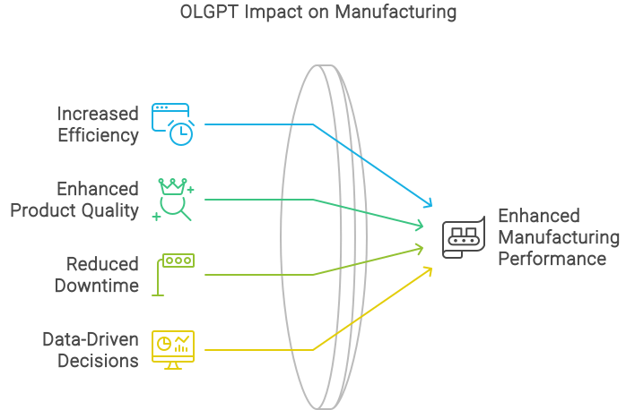
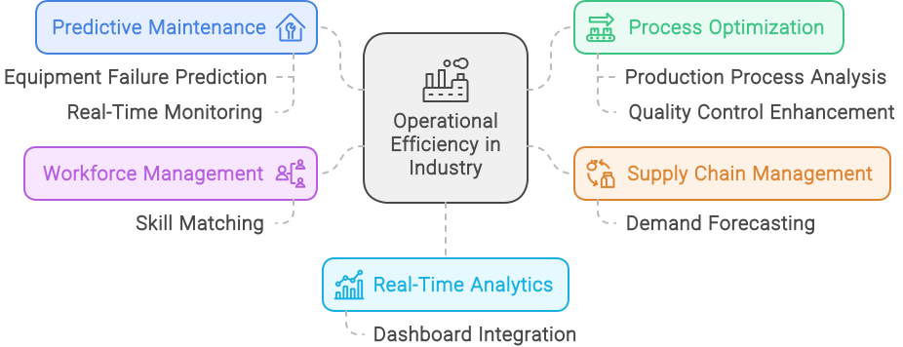
OLGPT in Manufacturing
Use Case: A manufacturer can reduce downtime by 25% with predictive maintenance solutions
Notes:
Key features:
Predictive Maintenance: OLGPT predicts potential equipment failures by analyzing historical data and real-time sensor readings.
Process Optimization: Analyzes production workflows to identify inefficiencies and bottlenecks.
Data-Driven Decision-Making: Integrates real-time analytics and reporting, providing insights into production efficiency, quality control, and maintenance activities.
Benefits:
Reduced Downtime and Maintenance Costs: By predicting equipment failures, OLGPT enables proactive maintenance, reducing unexpected downtimes and extending machinery lifespan.
Increased Production Efficiency: Process optimization leads to higher throughput, and overall improved efficiency in manufacturing operations.
Optimized Resource Utilization: Real-time production planning ensures efficient use of resources, timely fulfillment of orders, and better overall production management.
Informed Decision-Making: Data-driven insights empower manufacturers to make informed decisions that enhance productivity, improve quality control, and reduce operational costs.

Slide 11
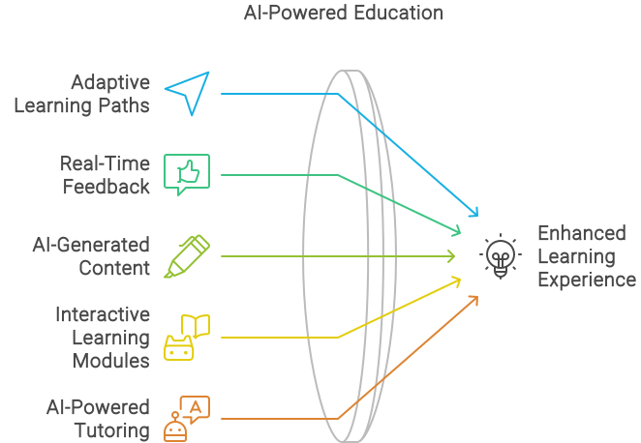
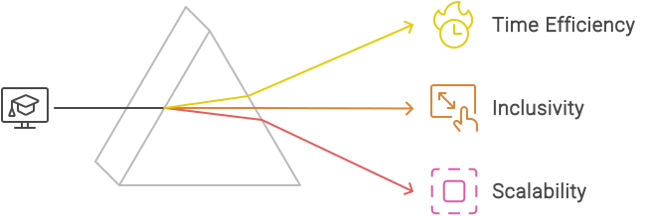
OLGPT in Education
Our Success Story: A college improved administrative process by 15% through predictive analytics
Notes:
Key Features:
Personalized Learning: OLGPT customizes learning experiences based on individual student needs, progress, and learning styles.
Content Creation and Curation: Automatically generates high-quality, SEO-friendly educational content and curates relevant resources aligned with curriculum standards.
Student Engagement: Develops interactive and immersive learning modules, incorporating gamification elements to motivate students.
Teacher Support and Professional Development: Offers instructional resources, personalized professional development modules, and facilitates collaboration among educators.
Benefits:
Enhanced Learning Outcomes: Personalized learning paths ensure that each student receives tailored instruction, improving engagement and academic achievement.
Efficient Content Delivery: Automated content creation and curation save educators time, allowing them to focus more on teaching and less on administrative tasks.
Professional Growth for Educators: Access to instructional resources and professional development modules empowers teachers to continuously improve their skills and adapt to new teaching methods.
Seamless Remote Learning: OLGPT supports remote and hybrid learning environments, ensuring that students and educators can effectively engage and communicate, regardless of location.

Slide 12
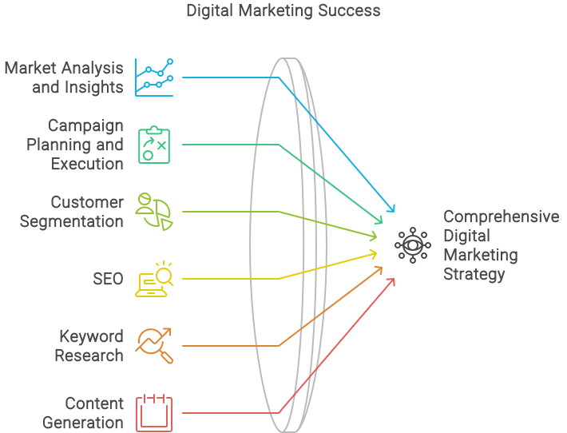
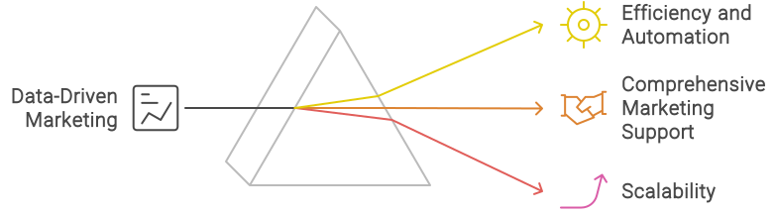
OLGPT in Marketing
Notes:
Key Features:
Strategy Planning: OLGPT assists in planning multi-channel marketing campaigns, defining target audiences, setting KPIs, and optimizing budgets.
SEO (Search Engine Optimization): Provides on-page SEO recommendations, conducts technical SEO audits, and develops localized SEO strategies.
Keyword Research: Generates relevant keywords based on industry trends and competitor analysis, including long-tail keyword optimization.
Content Generation: Automatically creates high-quality, SEO-friendly content for blogs, landing pages, and product descriptions, tailored to your brand’s voice.
Website Implementation: Optimizes website structure, landing pages, and facilitates A/B testing to determine the most effective design and layout.
Social Media Content Calendar: Manages a social media content calendar, automating content scheduling and generating platform-specific content.
Data-Driven Insights and Analytics: Provides real-time analytics on campaign performance, user engagement, and website metrics, empowering data-driven decision-making.
Benefits
Conversational Chat interface to website: Enhances your chat interface on website to address website visitors query
Comprehensive Marketing Strategies: OLGPT helps develop and execute well-rounded marketing strategies, ensuring all aspects of your digital marketing are aligned and optimized for success.
Improved Search Engine Rankings: With robust SEO and keyword research tools, OLGPT enhances your website’s visibility, driving more organic traffic and improving search engine rankings.
High-Quality Content Creation: Automated content generation saves time and ensures that your marketing content is both relevant and optimized for SEO, boosting engagement and conversion rates.
Optimized Website Performance: OLGPT’s recommendations for website structure and landing pages enhance user experience and increase conversion rates by ensuring your website is effective and user-friendly.
Efficient Social Media Management: The automated content calendar and platform-specific content creation streamline social media marketing, ensuring consistent engagement across all platforms.
Informed Marketing Decisions: Real-time analytics and insights enable marketers to make data-driven decisions, optimize campaigns on the go, and maximize ROI.
Scalable Solutions: Whether for small businesses or large enterprises, OLGPT's modular approach allows you to scale your marketing efforts efficiently, adapting to changing market conditions and business needs.

Slide 13
Thank you!!!
For enquiries, contact business@amvionlabs.in
044-35113668

